Slide 1
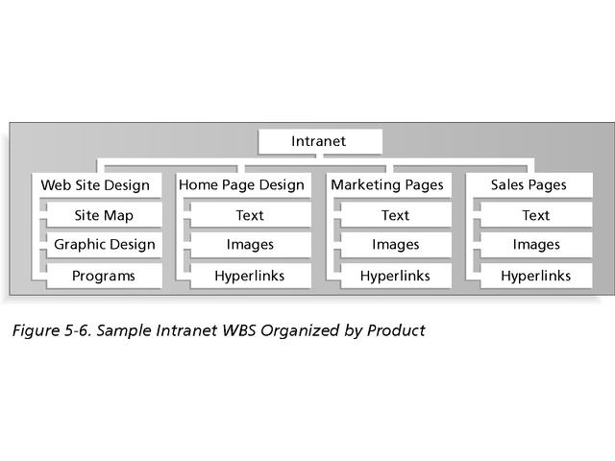
Example : WBS for Intranet by Product

Slide 2
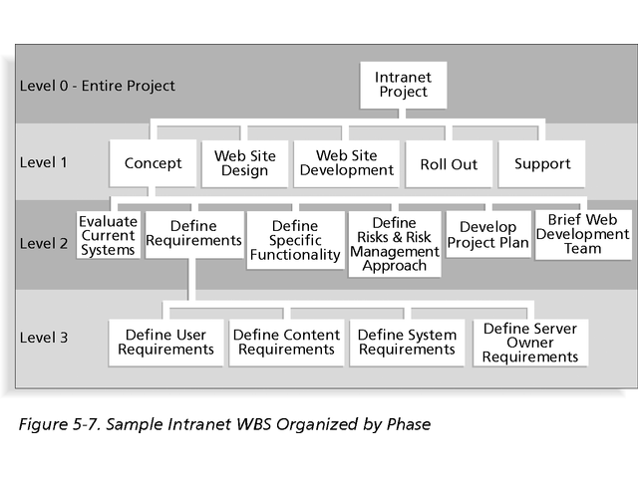
Example : WBS for Intranet by Phase

Slide 3
Example : WBS for Intranet in Tabular Form
1.0 Concept
1.1 Evaluate current systems
1.2 Define Requirements
1.2.1 Define user requirements
1.2.2 Define content requirements
1.2.3 Define system requirements
1.2.4 Define server owner requirements
1.3 Define specific functionality
1.4 Define risks and risk management approach
1.5 Develop project plan
1.6 Brief Web development team
2.0 Web Site Design
3.0 Web Site Development
4.0 Roll Out
5.0 Support

Slide 4
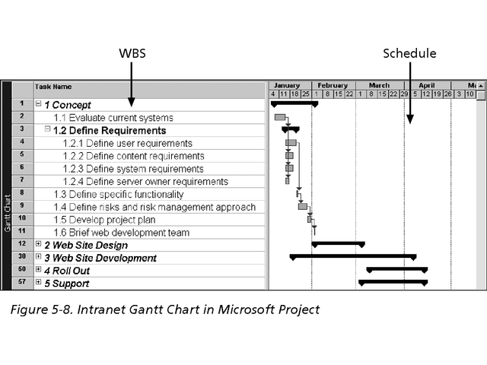
Example : WBS for Intranet with Gantt Chart

